Slide 1
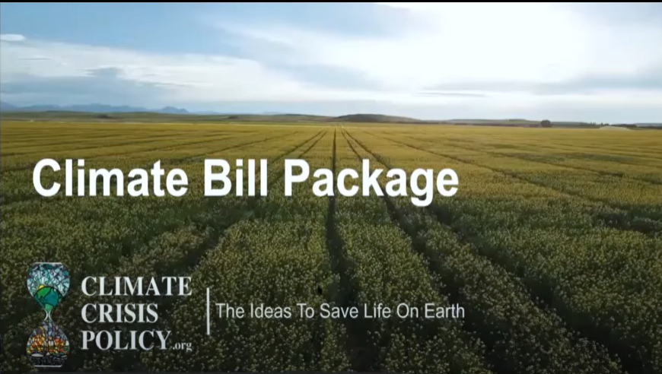
2020-21

Slide 2
2020-21 BLL NAME | DISTRICT VOTES | GROUP VOTES
Materials 1. Break Free from Plastic Pollution Act of 2020 (H.R. 5845-2020) 2. American Innovation & Manufacturing Leadership Act of 2020 (H.R. 5544 – 2020) PASSED! 3. Protect America’s Children from Toxic Pesticide Act of 2020 (H.R. 7940 – 2020) Agriculture & Land Preservation / Forests and Wetlands 4. Farm System Reform Act of 2020 (S.3221 – H.R.6718 – 2020 5. Food & Agribusiness Merger Moratorium Act (S.3404 – H.R.6800 - 2018) 6. Climate Stewardship Act (S.2454 – H.R.4269 – 2019) 7. Agriculture Resilience Act (H.R. 5861 – 2020) Fossil Fuel Management 8. Fracking Ban Act (S. 3247 – H.R.5857 – 2019) 9. End Polluter Welfare Act of 2020 (H.R. 7781 – 2020) Environmental Justice and Just Transition 10. Environmental Justice For All Act (H.R.5986 – 2020) NEW 2021-22 Climate Bill International Forest Protection & Crime-Free Supply Chain (Temporary Name, Not Yet Filed) | 86 28 15 17 17 10 22 21 16 64 | 501 6 25 16 241 80 47 568 0 0

Slide 3
Materials 1. Break Free from Plastics Pollution Act of 2020
92% of plastic waste in America is never recycled
Plastic industry warms the planet at twice the rate of airline industry
______________
Holds corporations responsible for cleaning up plastic pollution
Reduces & bans single-use non-recyclable plastic products
Establishes a nationwide 10¢ bottle return refund program
Halts construction on all new plastic-polluting facilities
Prevents plastic waste from being shipped to
developing countries

Slide 4
Materials 2. American Innovation & Manufacturing Leadership (AIM) Act
Targets hydrofluorocarbons (HFCs), the industrial gas widely used in refrigeration, air-conditioning and building insulation
PASSED! as part of the end-of-year, omnimbus legislation that became law on December 27, 2020
______________
85% reduction in manufacturing and import of HFCs by 2036
Instructs EPA to implement leak prevention and disposal requirements to manage existing products using HFCs
Creates 33,000 manufacturing jobs and 2.5M industry jobs by 2027

Slide 5
Materials 3. Protect America’s Children from Toxic Pesticides Act of 2020
U.S. uses over a billion pounds of pesticides annually, nearly a fifth of all pesticides used in the world
_____________
Bans some of the most harmful pesticides that are still in use
Suspends pesticides deemed unsafe in Canada & EU
Protects frontline communities impacted by pesticide exposure & empowers them to take action

Slide 6
Agriculture and Land Preservation 4. Farm System Reform Act
Targets large concentrated animal feeding operations (CAFOs) which produce enormous amounts of waste and harmful pollution
______________
Phases out factory farm CAFOs by 2040
Halts new construction and expansion of
large CAFOs
Invests $100B over 10 years for a just
transition to regenerative farming practices
Joe Wertz/Center for Public Integrity

Slide 7
Agriculture and Land Preservation 5. Food & Agribusiness Merger Moratorium Act
Four beef companies produce 85% of beef in America; four corporations control nearly 90% of U.S. grain market
The share a farmer gets from each retail dollar has fallen from 41¢ in 1950 to 15¢ currently
______________
Immediately halts corporate consolidation within farming industry, food and beverage manufacturing, and grocery retail
Establishes a commission to investigate impact of hyper consolidation within these markets

Slide 8
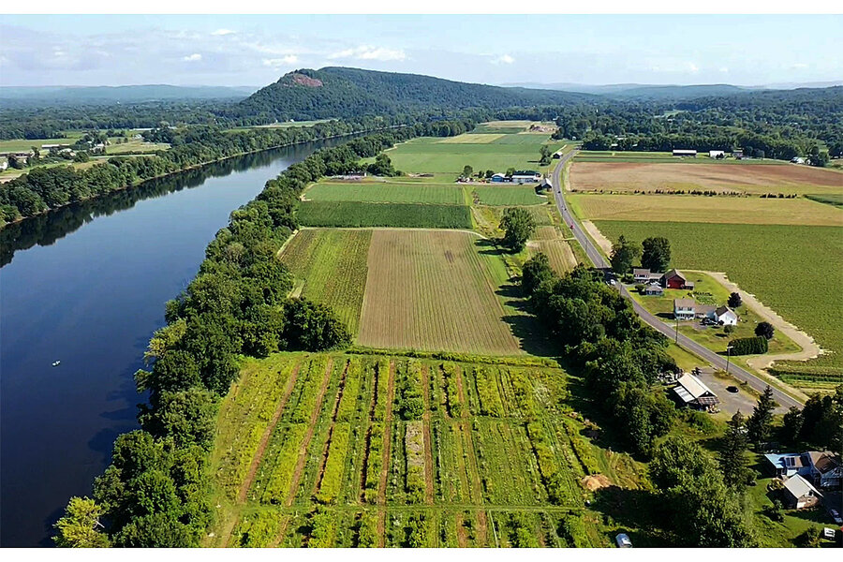
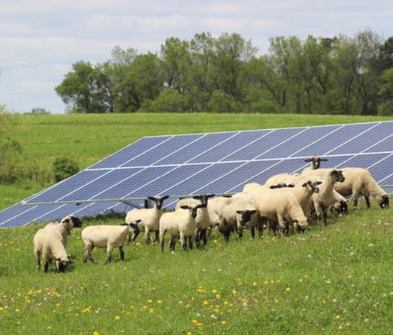
Agriculture and Land Preservation 6. Climate Stewardship Act
__________________________________________________________
Funds & expands existing federal programs to reduce or offset one-third of agricultural emissions by 2025
Provides technical assistance to help farms incorporate climate stewardship practices
Incorporates grant funding for clean on-farm energy
Plants 16 billion trees, including 400 million in urban areas
Restores and protects 2 million acres of essential coastal wetlands
Invests in regional food systems
Remy Schneider

Slide 9
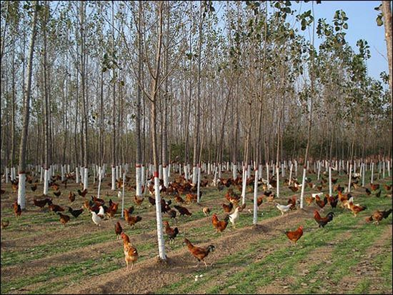
Agriculture and Land Preservation 7. The Agriculture Resilience Act
______________
Rewards farmers for promoting carbon sequestration & healthy soil
Invests in research and support for farmers practicing pasture-based livestock systems
Establishes grants and loans to help farms transition to green energy
Creates robust new federal programs aimed at reducing food waste in schools and standardizing food date labels

Slide 10
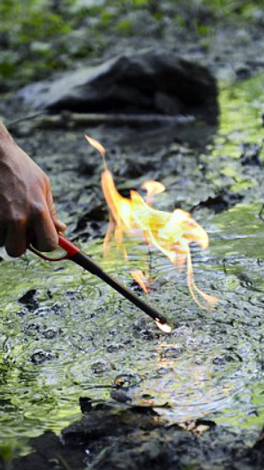
Fossil Fuel Management
8. The Fracking Ban Act
__________________________________________________________
______________
Bans fracking nationwide by January 1, 2025
Immediately halts permits for fracking and fracking infrastructure
Revokes current permits for fracking wells within 2,500 feet of homes, schools, and other inhabited structures
Establishes a just transition committee for fossil fuel works and to protect the public health of communities that have relied on the fossil fuel economy

Slide 11
Fossil Fuel Management 9. End Polluter Welfare Act . ____________________________________
______________
Eliminates up to $150B in federal subsidies to the fossil fuel industry over 10 years
Updates the under-market royalty rates for oil & gas production on federal lands, recoups royalties from offshore drilling in public waters
Prohibits taxpayer-funded fossil fuel research & development
Ensures funding for the Black Lung Disability Fund
Photo by: Martin Meissner, AP
Photo by: Martin Meissner, AP

Slide 12
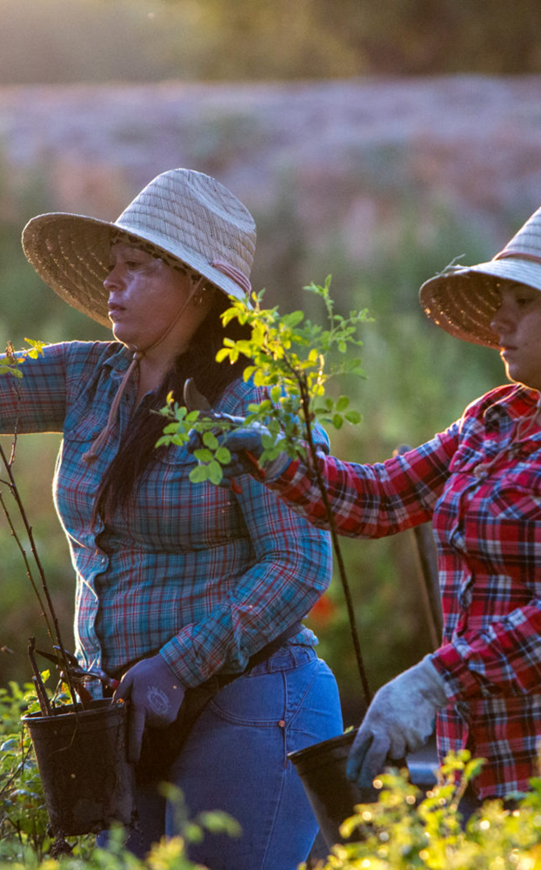
Environmental Justice & Just Transition 10. Environmental Justice for All Act
_____________________________________
Addresses disparities in environmental and public health particularly impacting underserved communities of color
______________
Amends Civil Rights Act to allow citizens & communities to seek legal remedies when policies or practices cause a disparate impact
Allocates $75M annually for research & program development to reduce public health disparities
Requires federal agencies to consider cumulative health effects
Provides economic assistance for fossil fuel-dependent communities and just transition for workers

Slide 13
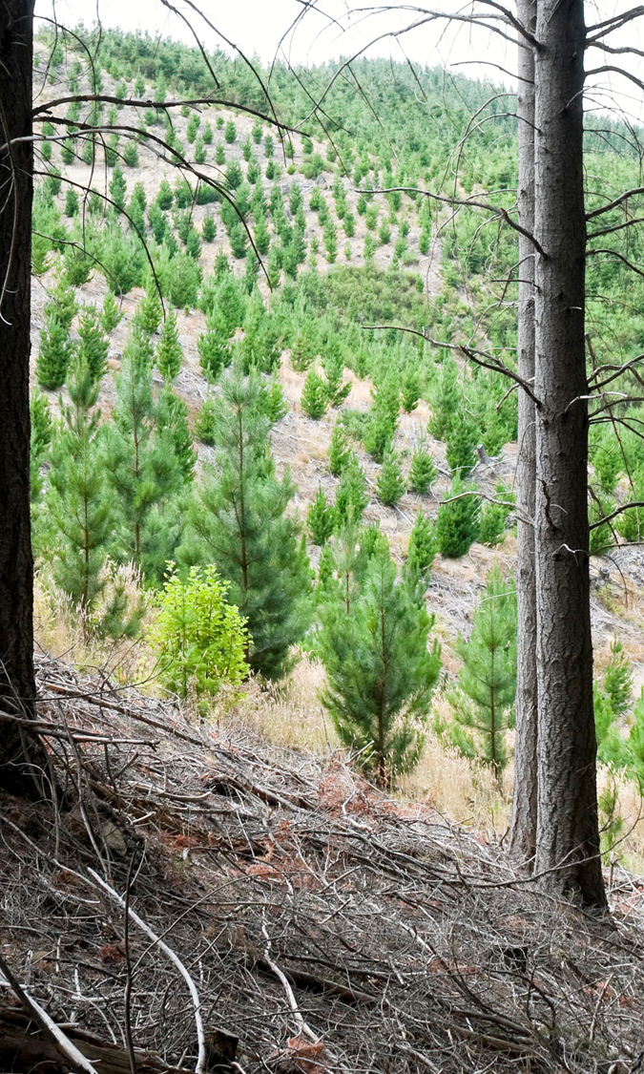
NEW 2021-22 Climate Bill
International Forest Protection & Crime-Free Supply Chains
_______________________________________
The world is losing an area of forest the size of Virginia every year
Deforestation, of which 90% is illegal, is one of the biggest contributors to climate change and biodiversity loss, and increases human exposure to zoonotic diseases such as Ebola and coronaviruses
______________
Enacts significant trade rules and policy measures to protect the health and well-being of the world’s forests and the people who depend on them
Prevents agricultural commodities produced on illegally-deforested land from entering the U.S. market
Protects indigenous communities from land invasions and violence

